Slide 1
Predicting the Car Crash Severity

Slide 2
Predicting car crash severity is important to driver
This project will build a predicting system to identify the factors which are effecting the traffic crash severity.
If there are AI deploy in the car in future, the car can give advance to driver, such that to avoid accident happens.

Slide 3
Data acquisition and cleaning
Dataset from 01/01/2004 to 24/04/2020, provided by the course material.
Useful attributes are
'SEVERITYCODE','X','Y','ADDRTYPE','COLLISIONTYPE','PERSONCOUNT','PEDCOUNT','PEDCYLCOUNT','VEHCOUNT','INCDATE','INCDTTM','JUNCTIONTYPE','SDOT_COLCODE','UNDERINFL','WEATHER','ROADCOND','LIGHTCOND','SPEEDING','ST_COLCODE','HITPARKEDCAR’
Number of records after filtering are 7297.

Slide 4
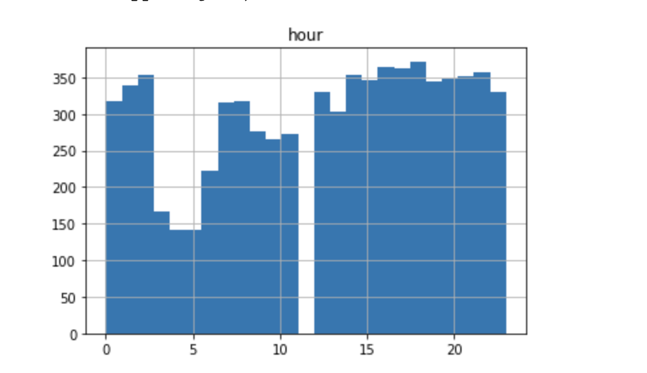
Exploring Data Analysis
Without incident in the period of 11:00 – 12:00 in the filtered dataset

Slide 5
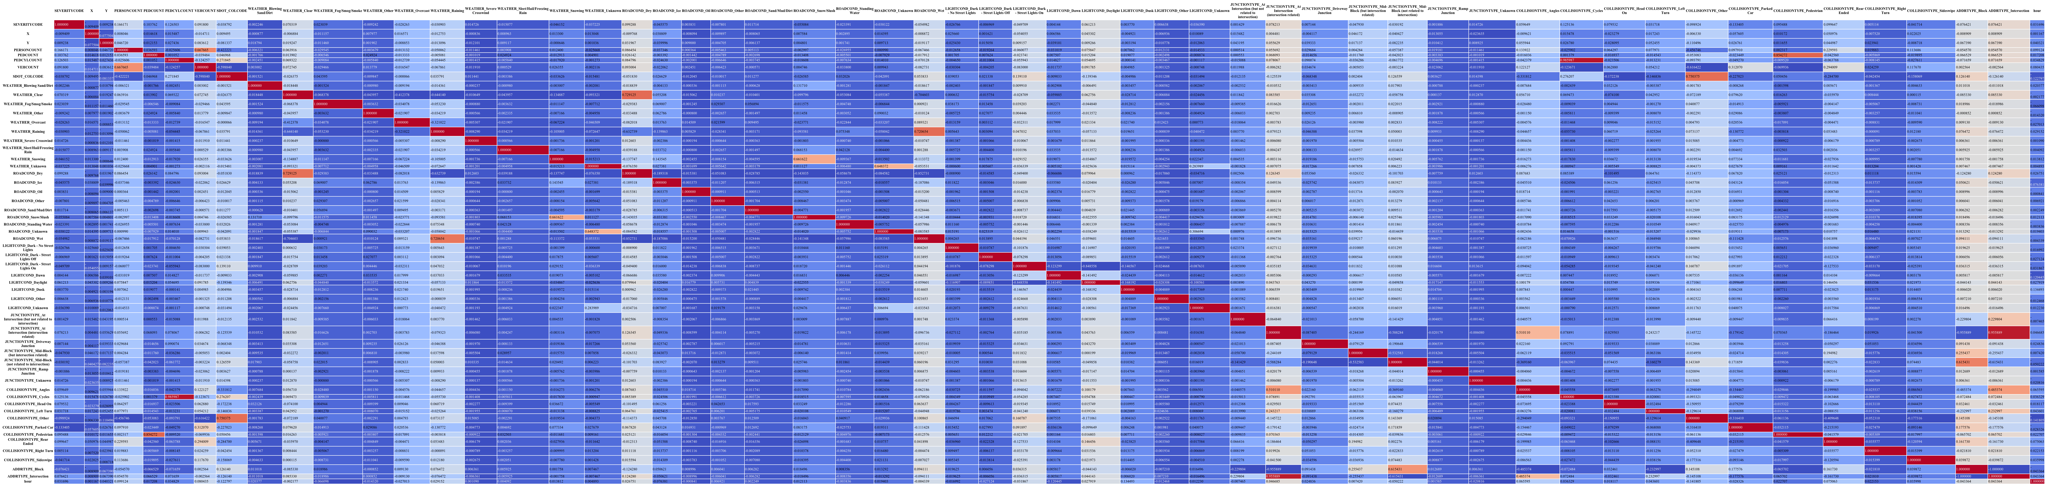
Correlation between the attributes

Slide 6
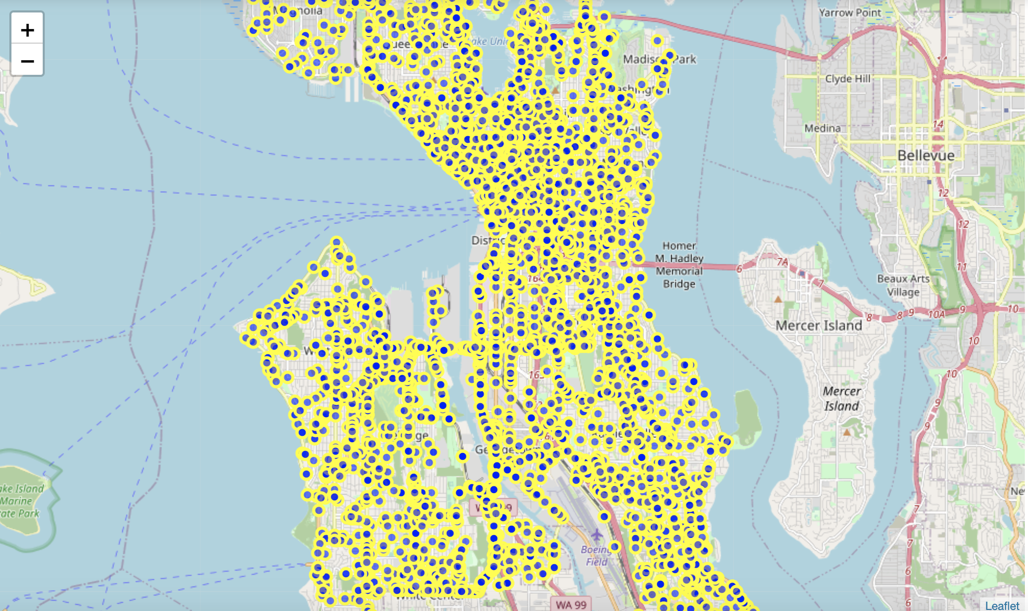
Incident locations – largely distributed

Slide 7
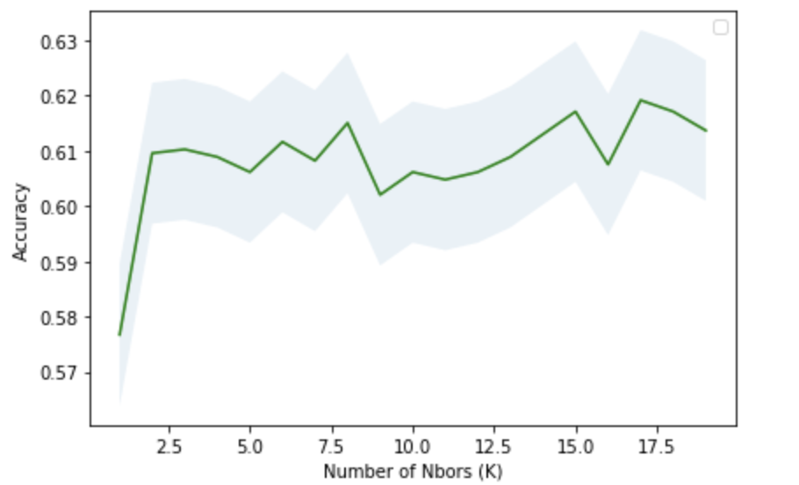
Predictive Modelling – by KNN
Maximum of accuracy occur when K is 17

Slide 8
Conclusion
I was able to achieve ~62% of accuracy on the classification. Although there are many different external attributes, the driver’s driving year experience may be a good indicator to affect the car incident. So, if possible, to include the driver experience year is a good choice to improve the prediction accuracy.

